Slide 1
Spring 2026
Innovation Academy Registration Prep
Robert Kwong

Slide 2


Congratulations and Welcome!

Slide 3
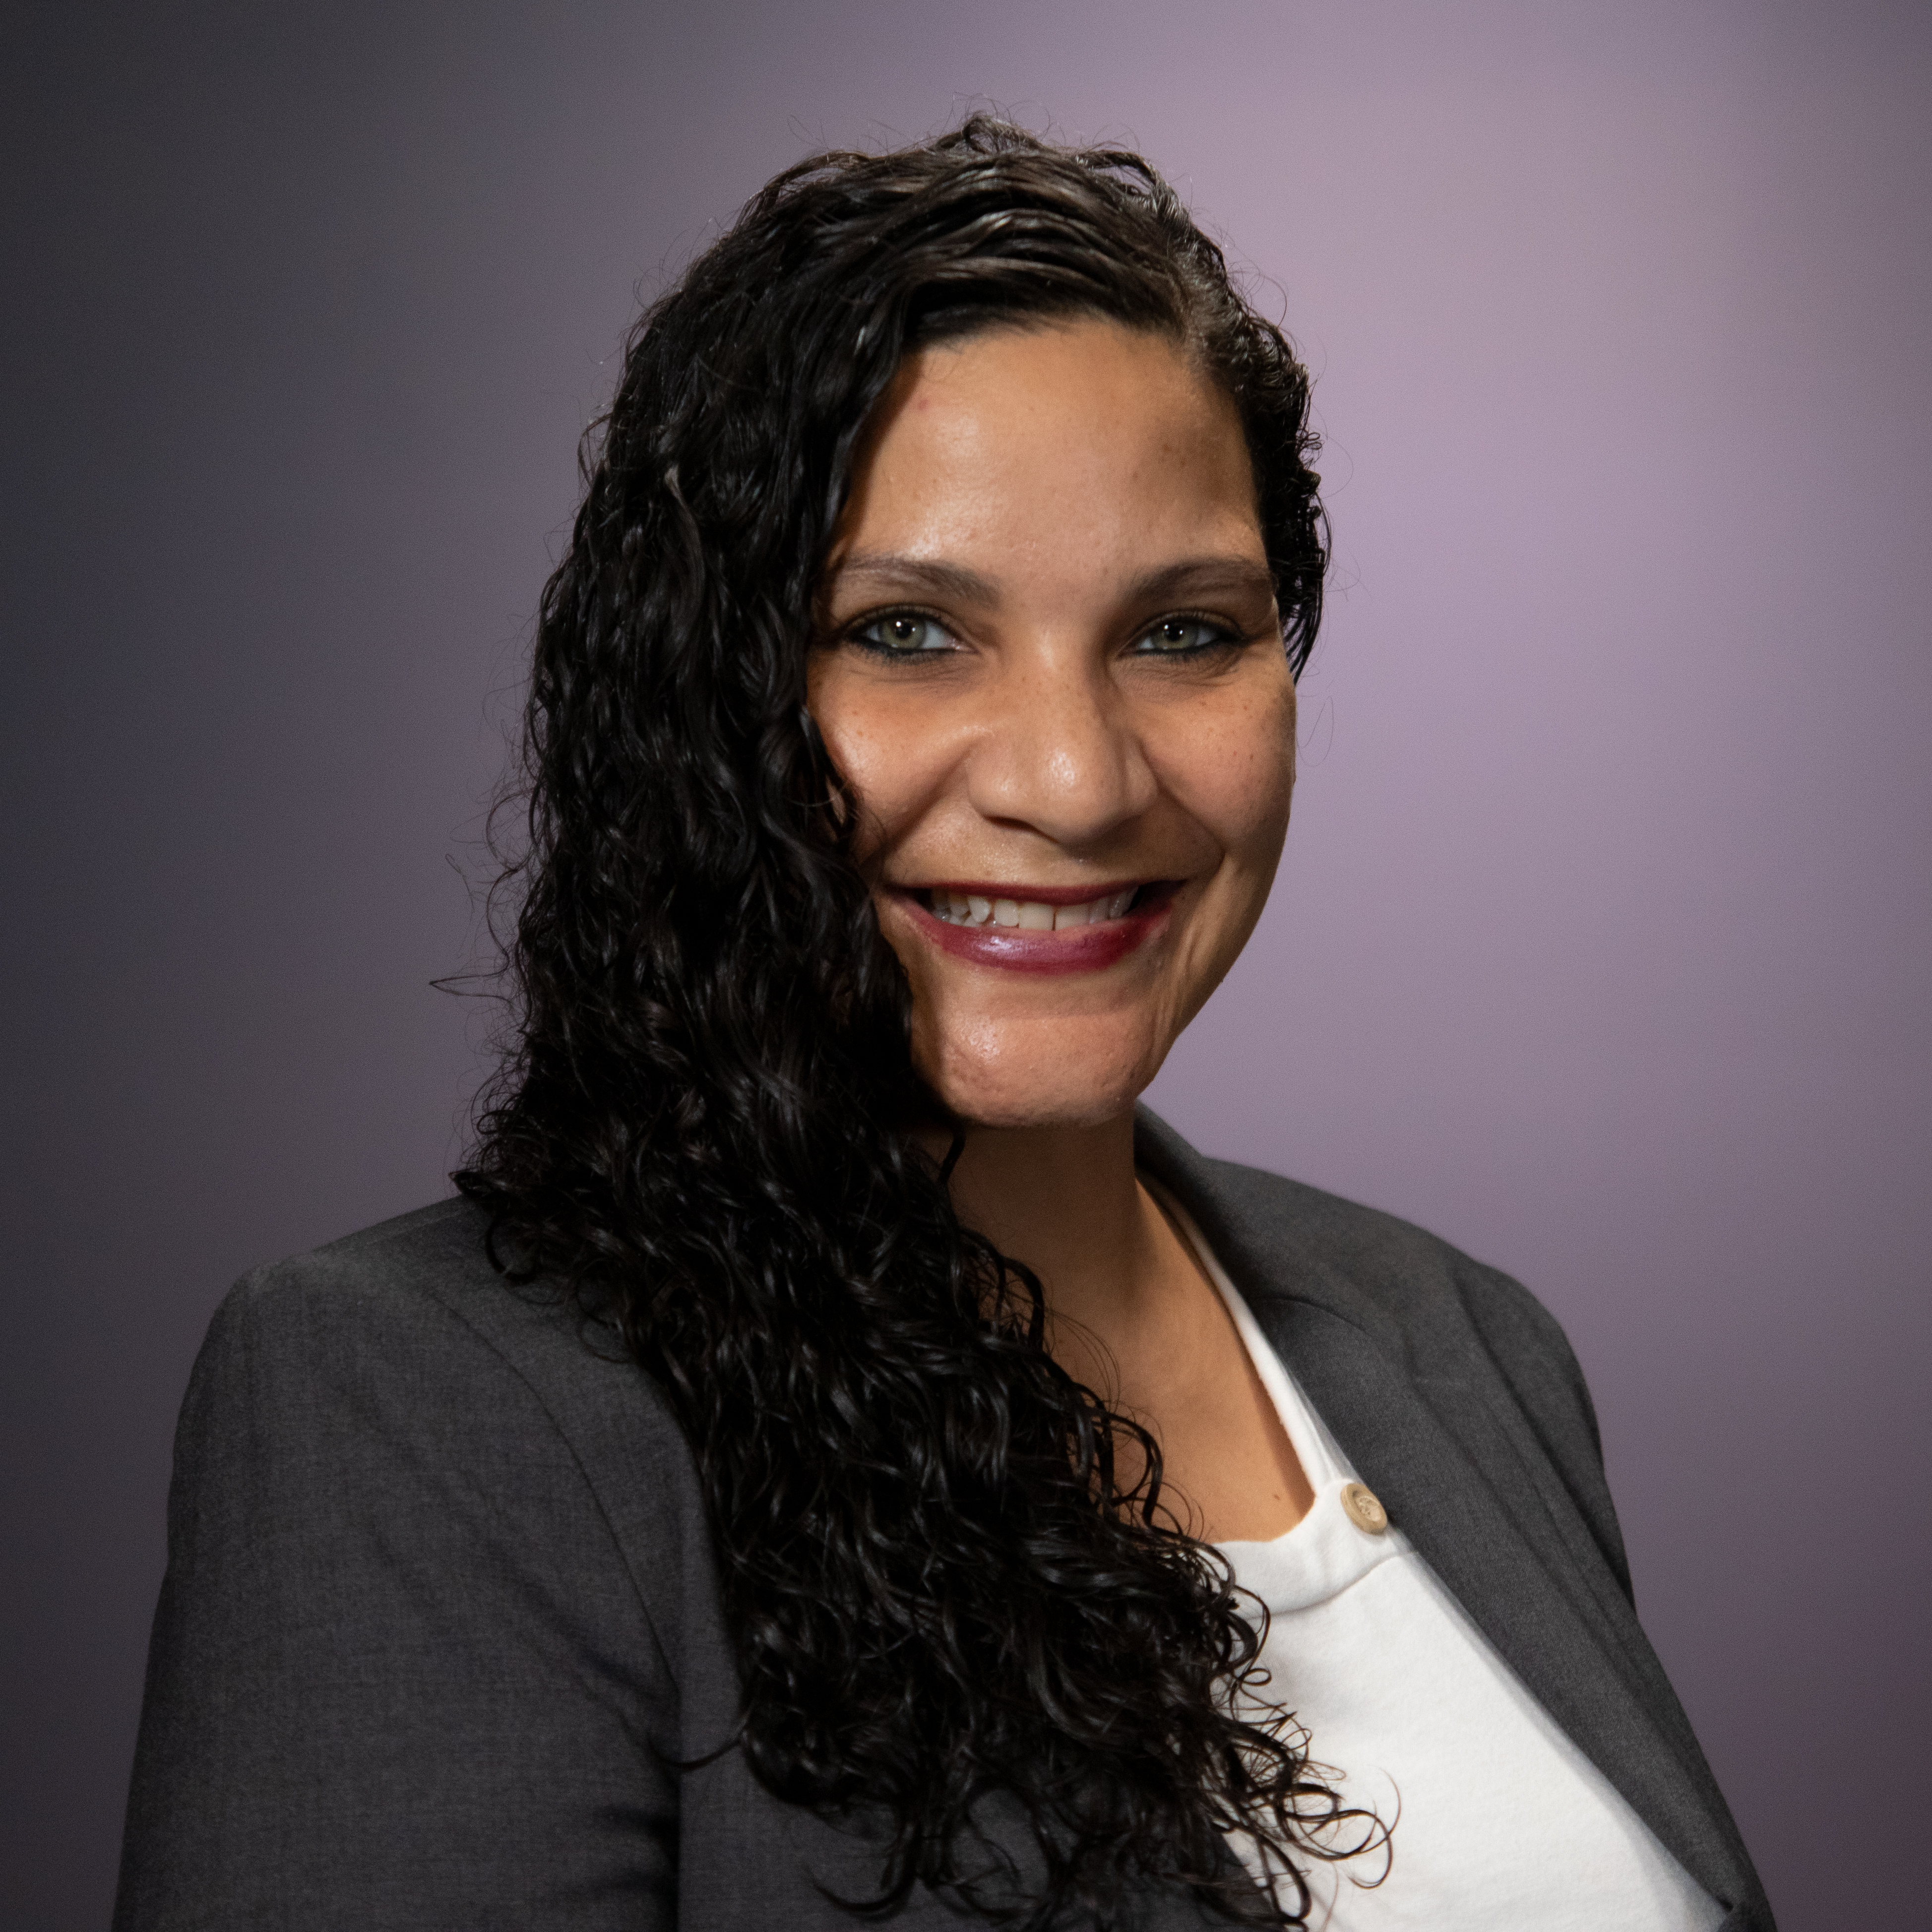
IA Advising https://innovationacademy.ufl.edu/academics/advising/
Amy Freeman
InnovationAdvisor@aa.ufl.edu
Janna Edwards
InnovationAdvisor@aa.ufl.edu

Slide 4

CLAS General Advsing https://www.advising.ufl.edu/advising/staff/
Robert Kwong
CLAS General Advisor
IA Advising Liaison
Transfer Advisor

Slide 5
What’s Ahead?
Book your Spring 2026 Registration Appointment
Look for November 10th e-mail with instructions
Schedule a registration appointment beginning 11/10
For the Dec 8 or Dec 9 appointment
Complete the Schedule Building Worksheet
Must be completed PRIOR to the registration appointment!
Meet for your 1-1 CLAS advising appointment on Dec 8th or Dec 9th
Remote via Zoom or In-person

Slide 6
What Needs to be Done Before Your AppointmenT?
Check for holds at ONE.UF
Only hold remaining should the IA Advising Hold, cleared when you are at your registration appointment
Confirm your Transfer Credit Report is updated (ONE.UF)
Test credits (AP, IB, AICE, CLEP)
Dual Enrollment/Transfer Coursework
All incoming credits should be posted by now
Request final transcripts to be sent to Admissions for any Fall 2025 courses completed elsewhere
Complete the Schedule Building Worksheet!!

Slide 7
Do I Need ALEKS?
YES
NO
Major requires CHM2045 or MAC1140 or higher
If you do not have incoming credit for Chemistry or Math that leads to Calculus.
Planning on pursuing Pre-Health courses
If you do not have incoming credit for Chemistry and/or Math that leads to Calculus.
Take the ALEKS at least 1 week prior to 12/1.
Major does not require CHM2045 or MAC1140 or higher
Not pursuing Pre-Health Courses
Already have incoming credit for Chemistry and/or Math that leads to Calculus.
This must be posted to your Transfer Credit Report.

Slide 8
QUEST Requirement
Students in the IA Program are exempt from Quest 1 and Quest 2.
You may still choose these courses, if you desire, as they can potentially count for other requirements:
Writing requirement
International
Biological or Physical Sciences
Humanities
Social and Behavioral Sciences

Slide 9
Building your Spring 2026 Schedule
12-14 credits minimum
Sample – Psychology
IDS 1940
1-2 Critical Tracking Courses for your Major (Semester 1)
1-2 Courses for CLAS Basic Distribution, College Requirements, or State Core Gen Ed or Writing Requirement
Additional electives (if needed)
IDS1940
MAC1140 or MAC1147 (Gen Ed Math)
PSY2012 (Basic Distribution Soc/Beh Sci, State Core Soc/Beh Sci)
ENC1102 (Basic Distribution Composition, State Core Composition, 6000 words)
AMH2020 (Basic Distribution Soc/Beh Sci, State Core Soc/Beh Sci, Civic Literacy)
ALEKS might be needed

Slide 10
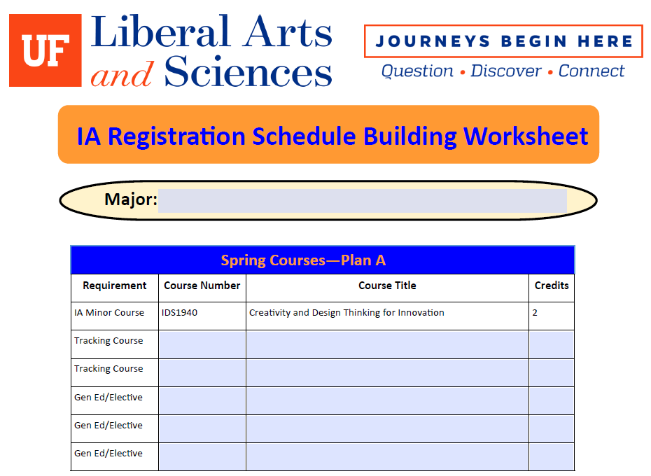
Schedule Building Worksheet

Slide 11
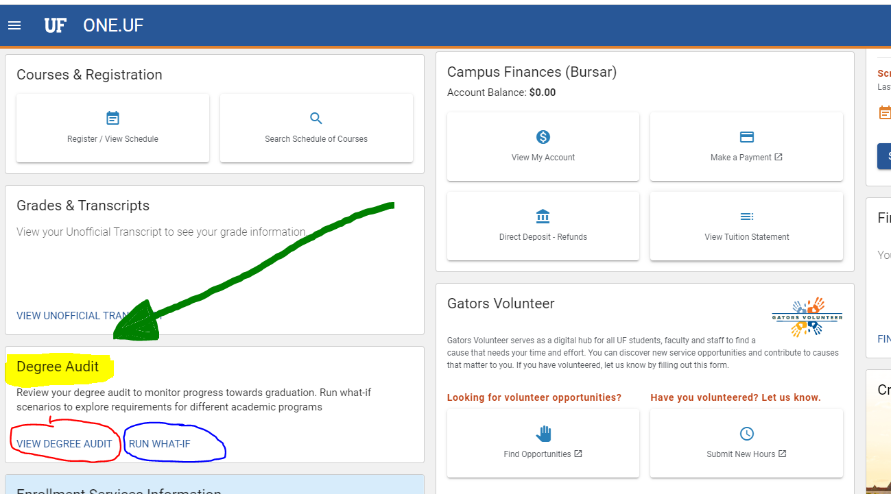
Building Your Spring Schedule
Use either the Degree Audit or “Run What If” at ONE.UF

Slide 12
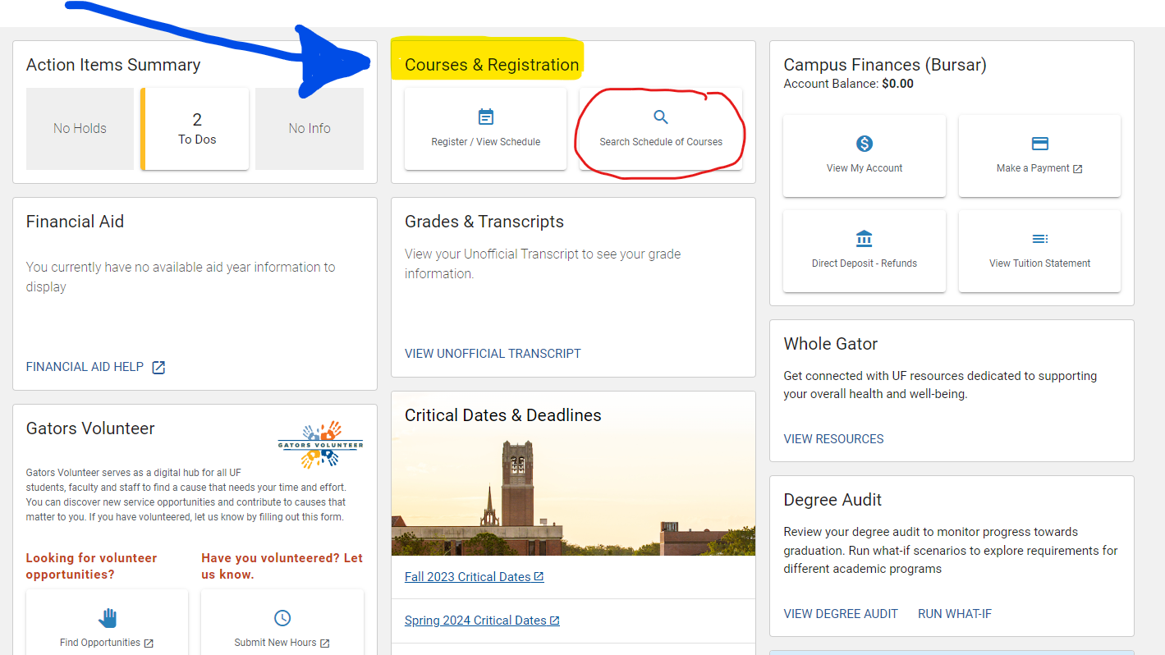
Looking At Spring Courses Offered

Slide 13
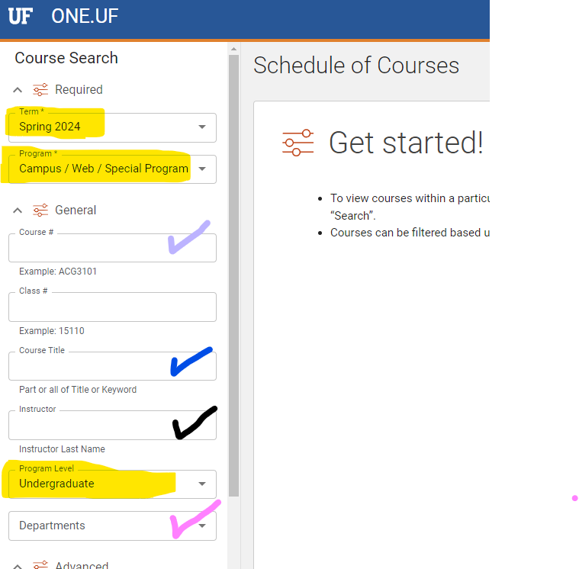
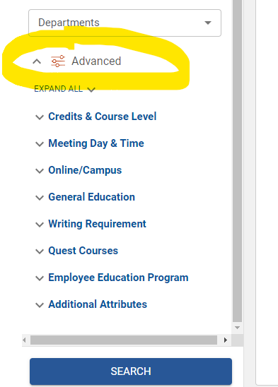

Slide 14
Building Your Spring Schedule
Look for these 2 sections in the Degree Audit/What-If FIRST!!
“Major Name – Critical Tracking Summary”
Review if any tracking courses are already completed or in-progress
List any courses that are remaining
“Major Name – Critical Tracking Progress” or “Critical Tracking”
This section tells you what courses must be completed at each semester.
If you are ahead in Tracking, you may enroll in the tracking courses for the next semester.
You may not skip courses that are specified in a specific term

Slide 15
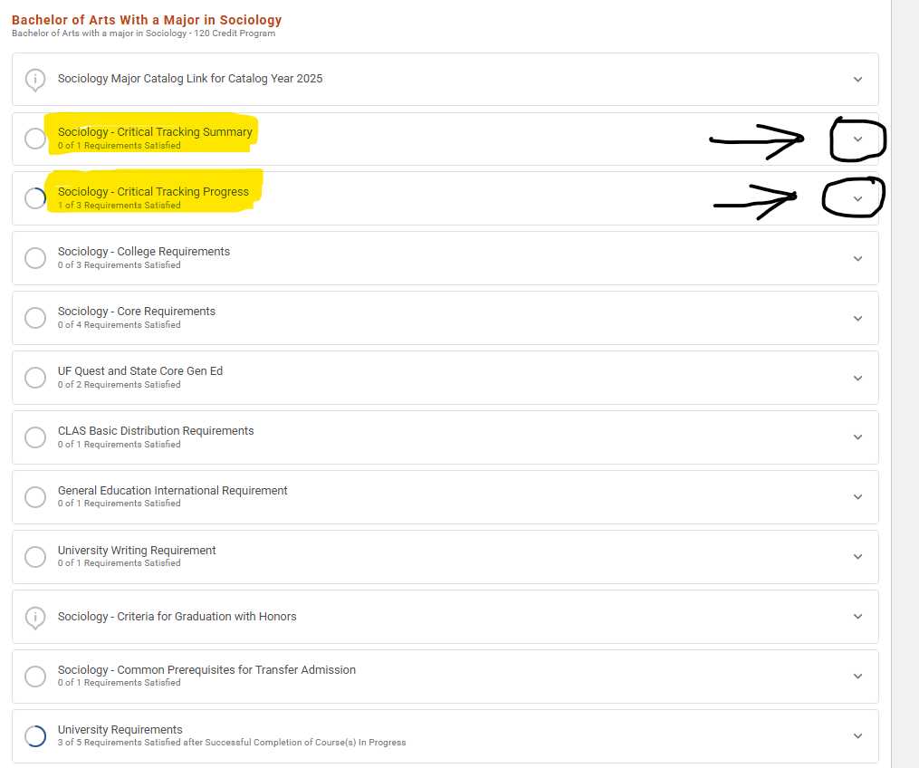

Slide 16
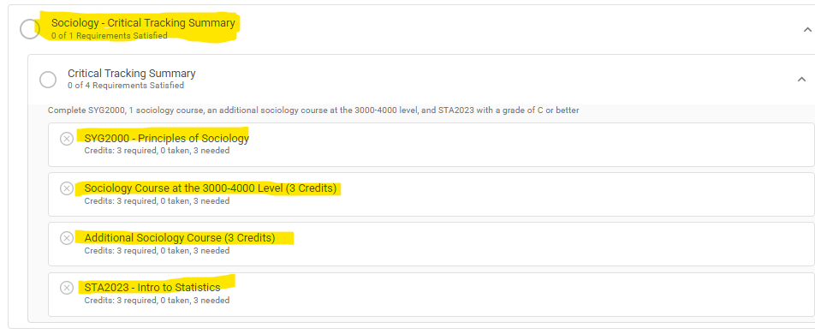

Slide 17
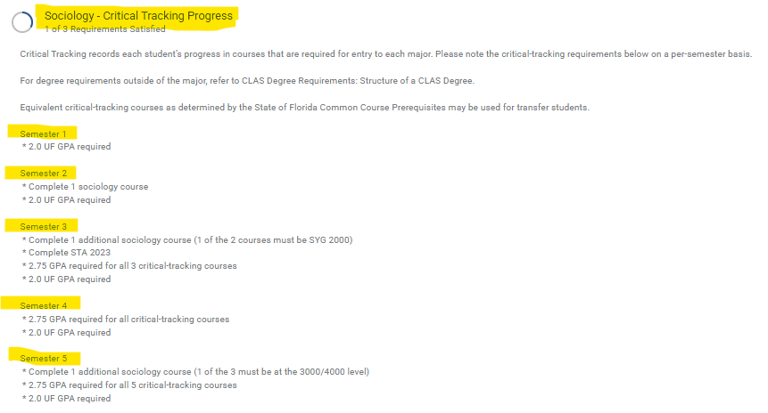

Slide 18
Building Your Spring Schedule List Any Remaining Requirements
Look for these sections in the Degree Audit/What-If, next
(expand each section so you can see the details)
“Major Name – College Requirements”
“UF Quest and State Core General Education”
“CLAS Basic Distribution Requirements”
“General Education International Requirement”
“University Writing Requirement”

Slide 19
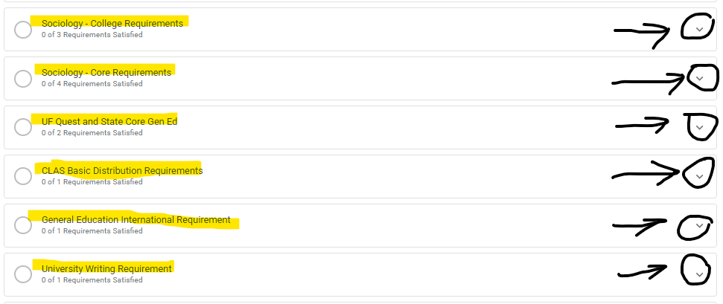

Slide 20
Registration Appointments
December 8 or December 9
8:30 am to 4:00 pm (EST)
30 minute appointments
Remote or In-person
Instructions for booking the appointment to be sent 11/10 via your UFL.EDU email address.
May begin booking appointments starting November 10th
These appointments are mandatory in order to be registered for Spring 2026.

Slide 21

Questions???

