Slide 1
Exploring Osteopathic Medicine for Pre-Meds
Notes:
Good afternoon and welcome from the American Association of Colleges of Osteopathic Medicine, AACOM. We are thrilled to be here. We appreciate the opportunity to share with each of you an overview of the osteopathic profession, and the application process.

Slide 2
What is Osteopathic Medicine?
Osteopathic medicine is a distinct pathway to medical practice in the United States.
Osteopathic medicine:
Provides all of the benefits of modern medicine including prescription drugs, surgery, and the use of technology to diagnose disease and evaluate injury.
Offers added benefit of hands-on diagnosis and treatment through a system of treatment known as osteopathic manipulative medicine.
Emphasizes helping each person achieve a high level of wellness by focusing on health promotion and disease prevention.
Notes:
As you may know, within the US there are two equal pathways to becoming a fully licensed physician. Some physicians receive the DO degree from a College of Osteopathic Medicine, and some physicians receive the MD degree from a school of medicine. There are many similarities to the pathways. Both require 4 years of medical school, followed by 3-6 years of internship or residency.
Osteopathic medicine provides its graduates with all the training to practice modern medicine. But it also offers an added benefit or skill set called osteopathic manipulative medicine (OMM). OMM is a hands-on technique used to treat various symptoms and alleviate pain. DOs are able to use OMM to discern abnormalities in the skeletal system and soft tissue so that they can better understand what may be causing an underlying condition contributing to a patient’s illness. OMM can be used to produce better lymphatic flow and can ease aches and pains. Imagine OMM as a tool in your toolbelt when treating your patient. In addition to prescriptions, ordering labs, doing a physical exam, or recommending surgery, you have an added tool called OMM that your MD counterparts do not have.
In addition to OMM, DOs believe in a holistic Mind-Body-Spirit approach to patient care. They practice partnering with their patients to address their physical, mental, and spiritual health.

Slide 3
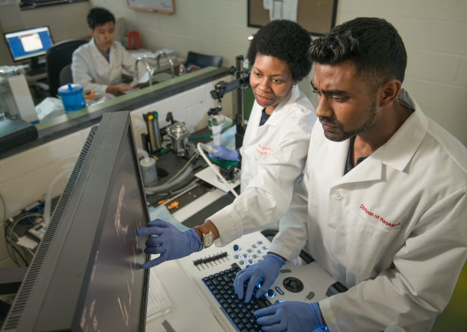
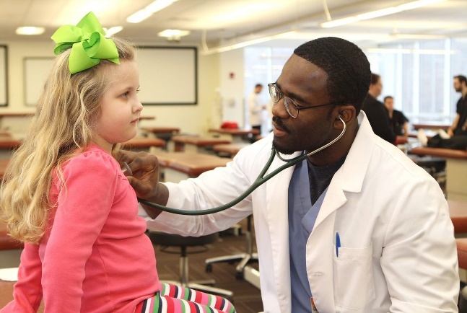
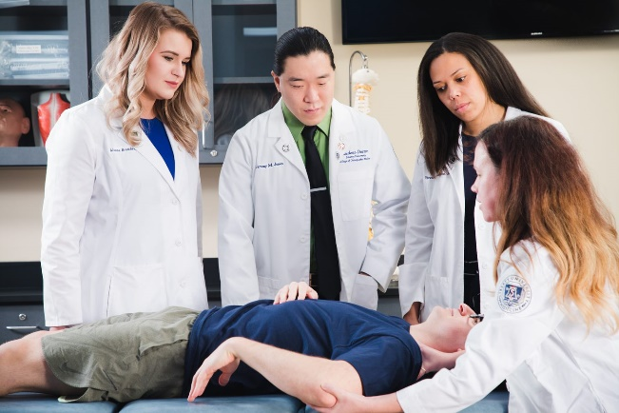
Doctors of Osteopathic Medicine, or DOs, are fully licensed physicians who practice in all areas of medicine. Emphasizing a whole-person approach to treatment and care, DOs are trained to listen and partner with their patients to help them get healthy and stay well.
Notes:
Osteopathic physicians practice in every medical specialty. Of DO graduates, about 56% practice in primary care specialties and 44% in other specialties, with many going on to subspecialize and complete further training in fellowships. There are also non-clinical areas of practice like medical research, medical education, health policy and hospital administration just to name a few.

Slide 4
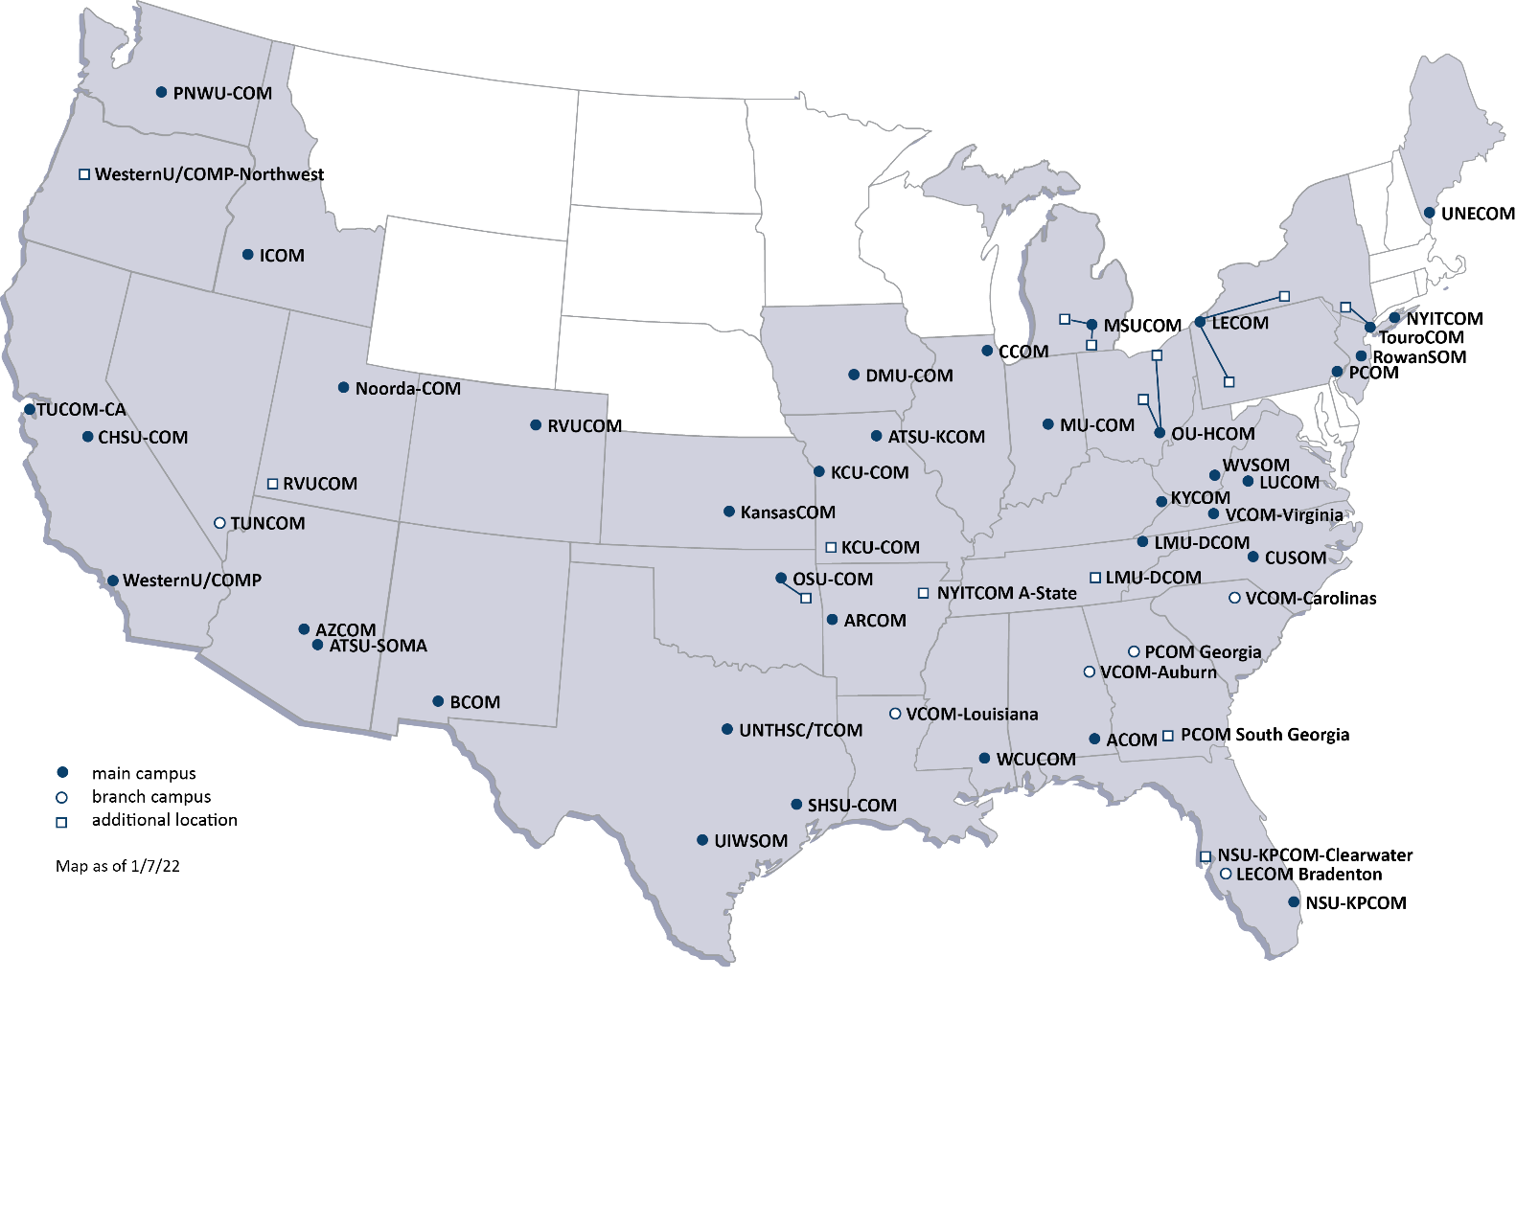

Slide 5
What Is AACOM?
American Association of Colleges of Osteopathic Medicine
The American Association of Colleges of Osteopathic Medicine (AACOM) was founded in 1898 to lend support and assistance to the nation's osteopathic medical schools, and to serve as a unifying voice for osteopathic medical education.
A Unified Voice
Innovation, Collaboration and Community
Centralized Services
Enhanced Awareness

Slide 6
AACOM’s Councils Key to Our Voice
CSFAA - Council of Student Financial Aid Administrators
Dev-Alum - Council of Development and Alumni Relations Professionals
ECOP - Educational Council on Osteopathic Principles
MAC - Marketing and Communications Advisory Council
SOME - Society of Osteopathic Medical Educators
Assembly of Presidents
Assembly of Osteopathic Graduate Medical Educators
Assembly of Council Leaders
CFO - Council of Fiscal Officers
CIT - Council for Information Technology
CDE - Council on Diversity and Equity
COMAO - Council of Osteopathic Medical Admissions Officers
COOL - Council of Osteopathic Librarians
COR - Council of Osteopathic Researchers
CORP - Council on Residency Placement
COSGP - Council of Osteopathic Student Government Presidents
CSA - Council on Student Affairs

Slide 7
What is COSGP?
Council of Osteopathic Student Government Presidents
Represents all 34,000 osteopathic medical students in the U.S.
Student Government Association Presidents and Vice Presidents from each campus are the members
Meets quarterly
National Osteopathic Student Congress in July
Student research meeting in Jan/Feb
Notes:
The Council of Osteopathic Student Government Presidents (COSGP) is an official council of the American Association of College of Osteopathic Medicine (AACOM). The Council was established in 1972 and was originally known as the Council of Student Presidents.
COSGP serves as the official national representative voting voice of all osteopathic medical students. Its members work to maintain communication, disseminate information, foster student leadership, and provide a mechanism for the exchange of ideas between students of different colleges of osteopathic medicine.
Purpose and Goals
The purpose and goals of the COSGP are as follows:
To assemble student leaders from each college of osteopathic medicine (COM)
To collaborate on issues affecting all osteopathic medical students
To foster the exchange of ideas, information, and problem solving affecting individual colleges of osteopathic medicine
To effectively communicate and represent the osteopathic medical student perspective to professional and educational organizations including AACOM, AOA, NBOME, and other relevant organizations – AOA Affiliates, Partnerships, and Teams
To encourage professional development and leadership among osteopathic medical students
To support and promote the principles and pride of osteopathic medicine among osteopathic medical students and the American public

Slide 8
Osteopathic Medicine by the Numbers:
33,800
Osteopathic
medical students
+
134,901
DOs in the U.S.
168,701
DOs & Osteopathic medical students
in the U.S. – 11% of all physicians
Source: AOA 2019 OMP Report
Notes:
The field of osteopathic medicine is a fast-growing community of amazing physicians. So, if you become a DO, what kind of community are you joining? Here’s a quick breakdown of osteopathic medicine by the numbers. Currently, there are more than 30,000 osteopathic medical students in the US, and almost 135,000 DOs practicing. Put that together, and you’ll be joining the ranks of more than 168,000 DOs and osteopathic medical students in the US.

Slide 9
Osteopathic Medicine by the Numbers:
43%
Of actively practicing DOs are women
67%
Of actively practicing DOs are under the age of 45
Source: AOA 2020-2021 OMP Report
Notes:
According to the AOA’s 2020-2021 Osteopathic medical profession report (OMP), 43% of actively practicing DOs are women, and 67% are under the age of 45.

Slide 10
Notes:
Osteopathic physicians practice both primary and specialty care. Here are the most commonly practiced fields by DOs.

Slide 11
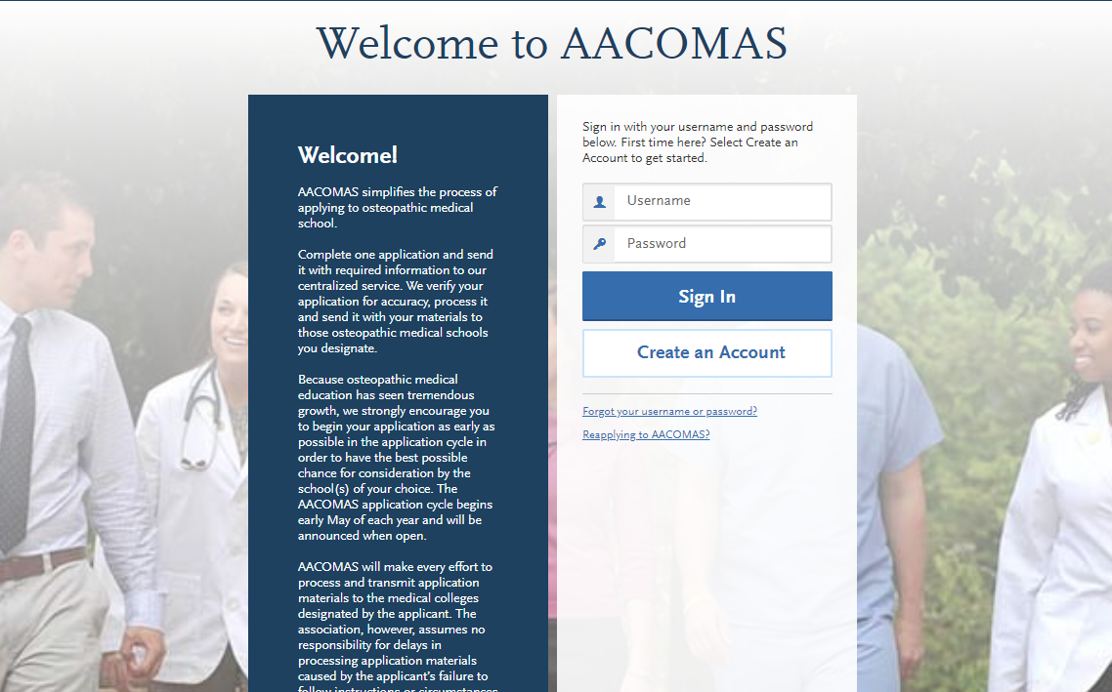
Applying Through AACOMAS
Notes:
Now, I’ll review some information about the AACOMAS application. If applying to osteopathic medical school is your next step, this presentation will help you better understand our American Association of Colleges of Osteopathic Medicine Application Service (AACOMAS). AACOMAS is the centralized application service for all US colleges of osteopathic medicine.
When applying, students start by selecting the programs they wish to apply to, & then submit one application that includes all necessary materials. Once received by AACOMAS, the application and materials go through a verification process before being transmitted to all the selected programs.

Slide 12
Application Timeline
May
June
Oct-Apr
AACOMAS opened for submissions in early May 2022
Colleges begin receiving and processing applications in mid-June 2022
Colleges may ask submitted applicants to complete a secondary application and begin inviting students to interview any time after this point
COM application deadlines range from October through April
Most colleges maintain AACOMAS deadlines in February and March
Admissions decisions are made on a rolling basis
Notes:
Here is the Application Timeline. AACOMAS opens the first week in May each year for entrance into medical school in the fall of the following year. You can submit any time after the launch of the cycle.
Colleges begin receiving and processing applications in mid-June. Once schools have access to the files in mid-June, they may begin to send secondary or supplemental applications, and invite for interviews at that time. We at AACOM like to point out that just because the application opens on May 4th does not mean that a student needs to submit right away. We suggest students not rush to submit, but rather submit when ready. We do encourage students to submit by fall to ensure that their application is reviewed before priority interview slots are filled.
All individual college application deadlines range from anywhere October through April of the following year; however, most AACOMAS programs maintain deadlines in February and March, and our Colleges do admit students on a rolling basis.

Slide 13
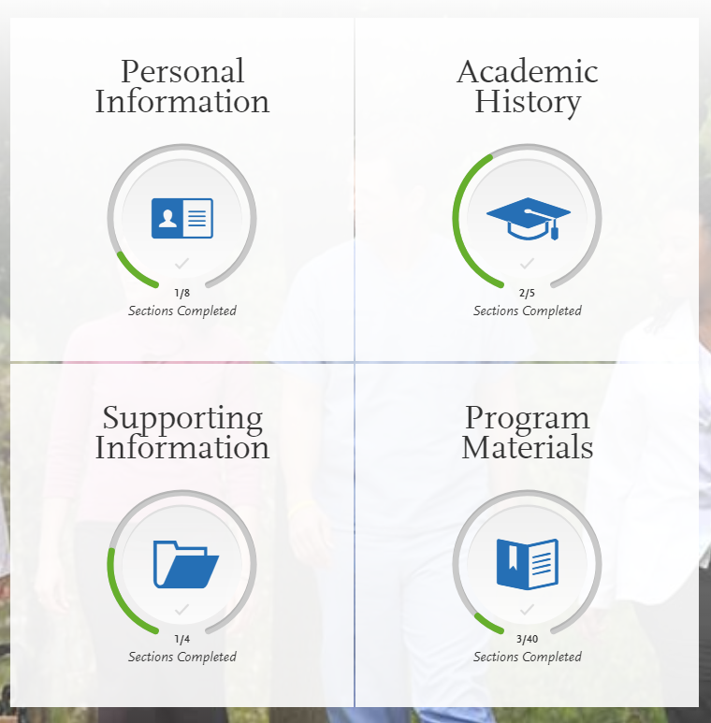
Application Overview – The 4 Core Sections
Personal Information
Background/Biographic Info
Academic History
Colleges Attended
Transcript Entry
MCAT Scores
Supporting Information
Letters of Recommendation
Experiences/Achievements
Personal Statement
Program Materials
General Admission Criteria & Process
Prerequisites
Custom Questions
Notes:
There are 4 core sections of the AACOMAS application. Each are accessible through the main application dashboard (pictured on the left). They are:
Personal Information
Background/Biographic Info
Contact Info
Academic History
Colleges Attended
Transcript Entry
MCAT Scores
Supporting Information
Letters of Recommendation
Experiences/Achievements
Personal Statement
Program Materials
General Admission Criteria & Process
Prerequisites
Custom Questions
The dashboard will also display an applicant’s progress filling out the application. The circles under the section headers on the dashboard will fill with green as each section is completed. The application is designed to be intuitive and easy-to-use, so a student should have little trouble completing it on their own. However, this presentation will cover some tips to complete each section and some common pitfalls to avoid.

Slide 14
Section 1: Personal Information
Background/Biographic Info
Contact Info
Release Statements & Certifications
Notes:
The Personal Information section is straightforward. Students enter their background information and contact information in Section 1.
This section also contains some key release statements and certifications. One release AACOM likes to highlight here is the advisor release. Selecting yes here enables pre-health advisors at the institutions a student has attended to see the status of their application. This information assists current advisors in guiding students through the application process.

Slide 15
Key Updates for the 2022-2023 Cycle
Additional COVID-19 Questions (Optional)
Did your school move to offering only online curriculum during the COVID-19 crisis?
Did you have an opportunity to receive a letter grade for any of your courses taken during the COVID-19 crisis?
Please describe how COVID-19 has impacted your pathway to medical school. (2500 characters) Items to consider incorporating in your response may include but are not limited to:
Academic: Were you able to interact with your professors? Did you have to leave an academic program stateside or abroad? Did your school require you to move to pass/fail grading systems? Did your MCAT exam get cancelled, delayed? Other academic barriers?
Professional: Did you hold a job? Did have to go out and seek new job opportunities? Did you lose a job? Other financial or professional barriers that you faced?
Personal: Did you have to move out of a house or dorm? Did you have to cancel travel plans? Did you modify your planned experiences related to healthcare or volunteer opportunities? Did you seek out volunteer opportunities that arose from the crisis? Did you assist any family or community members that were affected?
Notes:
AACOM recognizes that we are all in unchartered territory, and that COVID-19 has presented applicants with unforeseen challenges heading into the medical school application process. Knowing this, our team at AACOM has added three optional questions to the application in response to COVID -19. Our hope is that you will use these questions as an opportunity to share with our schools the obstacles you have faced.
We’ve listed the three additional optional questions on screen today. You’ll see the first question addresses whether your institutions moved to offering strictly online curriculum, and the second seeks to determine if you had the opportunity to receive a letter grade for any of their courses during COVID-19.
The last, is an essay question asking that you describe how COVID-19 has impacted your pathway to medical school. We have included help text that prompts you to consider any academic, professional, and/or personal hurdles COVID-19 has presented you. We do believe that it will add value to your AACOMAS application to answer the COVID-19 essay question. This is your opportunity to highlight how they have dealt with and shown perseverance during this pandemic.
It is very important to note that, if you opted to take pass/fail, this essay question is a perfect opportunity for you to explain the circumstances and reasoning for choosing pass/fail. Our schools will find this information highly valuable as they assess your application.

Slide 16
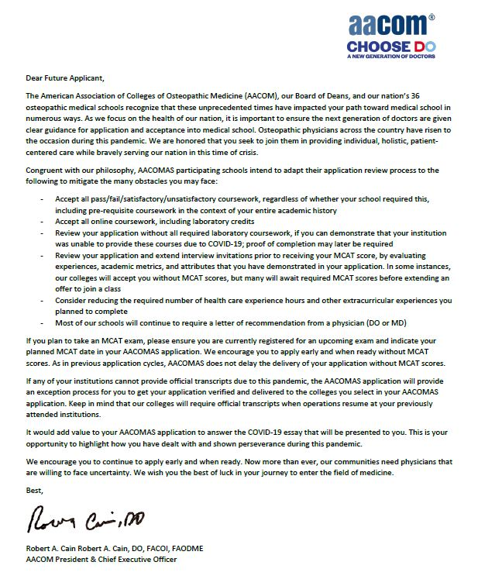
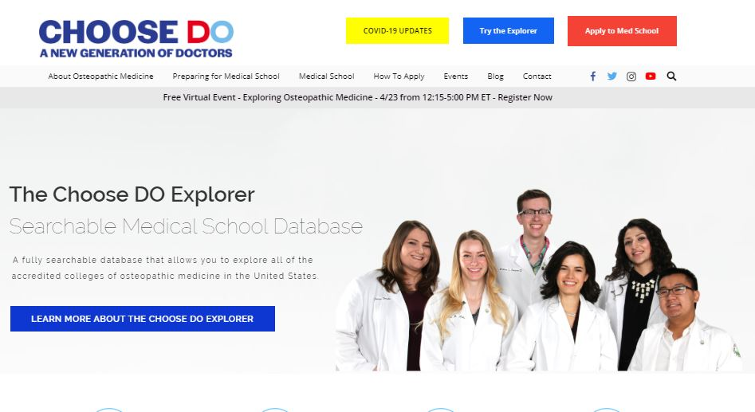
COVID-19 Updates & Resources
COVID-19 Resource Page
Osteopathic Medical Schools Adapt Admissions Processes in Response to COVID-19
AACOMAS FAQs
Relevant Blog Posts
Notes:
Hopefully by now everyone has visited our Choose DO Coronavirus page but if not, we encourage you to check out ChooseDO.org/coronavirus for up-t- date information from AACOM and our schools in response to COVID-19.
In addition to relevant blog posts and AACOMAS FAQs, including an open letter to applicants from AACOM’s President and CEO on behalf of AACOM and the Board of Deans from earlier this year.

Slide 17
How Have COMs responded to COVID-19?
Accept “pass” and “satisfactory” coursework offered in a pass/fail system for Spring 2020, including pre-requisite coursework..
Accept online coursework, including laboratory credits (when schools were not able to offer in person options).
Review your application without all required laboratory coursework, if you can demonstrate that your institution was unable to provide these courses due to COVID-19; proof of completion may later be required (Spring 2020 and forward).
Relax requirements for in-person healthcare experiences and in-person extracurricular experiences (Spring 2020 to present).
Schools will likely require applicants to demonstrate how they were able to obtain an understanding of what the clinical environment is like and show evidence of continued online health and extracurricular experience.
About a third of our schools will not require a letter of recommendation from a physician (DO or MD); the remainder are likely to require such a letter.
Most of our schools will offer an option for virtual interviews in place of in-person interviews.

Slide 18
Section 2: Academic History
Colleges Attended
Enter all colleges attended
Send official transcripts for each institution to AACOMAS
Transcript Entry
Enter each term (semester, quarter, trimester)
Enter each course taken under the corresponding term
The course code, title, subject, credits, and grade should match your transcript exactly
Tip: Download an unofficial transcript to complete this process correctly
Notes:
The second section is the Academic History section. Applicants typically spend the longest amount of time completing this section. Here, students enter all colleges they have attended, enter in all coursework completed at those institutions, and enter their MCAT score information.
Students will need to enter all institutions attended, regardless of their relevance to the programs they are applying to. Failure to report an institution may cause an application to be undelivered, which can significantly delay the processing of an application. These institutions may include, but is not limited to:
courses taken in high school for college credit
summer courses
community college courses
US military academies (please note that this does not include courses on SMART or JST transcripts)
post-baccalaureate, graduate, and doctoral work
study abroad, Canadian, and foreign work, etc.
Applicants will need to send the official transcripts of each institution to AACOMAS. A downloadable transcript request form that students can submit to their registrar’s office will be available for each college entered into AACOMAS.

Slide 19
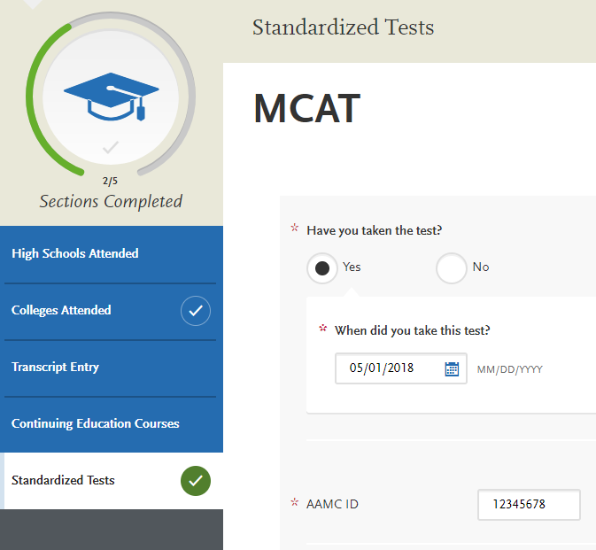
Section 2: Academic History
Submitting official MCAT scores is a 2-step process:
Accurately report your name, date of birth, and AAMC ID in AACOMAS application.
Use the AAMC’s online MCAT Score Reporting System to electronically release official scores to AACOMAS.

Slide 20
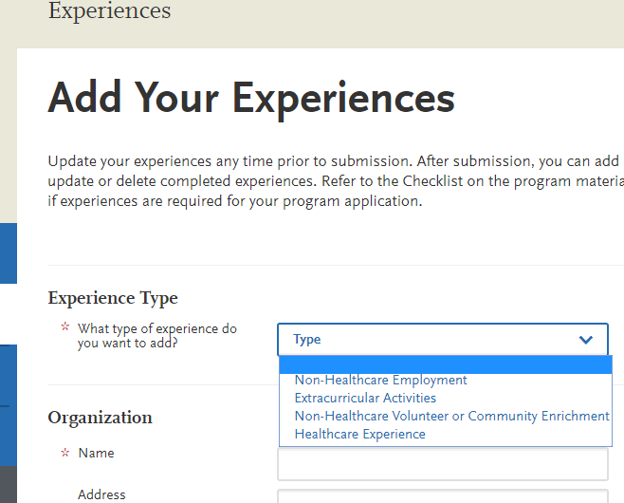
Section 3: Supporting Information
Letters of Recommendation
Experiences
Achievements
Personal Statement
Notes:
Letters of Recommendation
Can request individual letters, committee letters, and letter packets through AACOMAS
Determine letter requirements of programs in advance
Letter requirements are listed in the Choose DO Explorer, on college websites, and may be on each college’s program page within AACOMAS
Many colleges will indicate they prefer a letter of recommendation from a DO; however most colleges require letters from either a DO or MD
AACOM recommends giving letter writers 4-6 weeks advance notice before they need to submit the letter
Experiences
GOAL: Assess interest in health care, communication, helping others, patient population; Demonstrate engagement and time management​
Volunteer Opportunities​
Campus Volunteer Resources​, Search engines, Hospitals/Nursing Homes/Red Cross/Hospice​, Alternative Service Breaks / etc. ​
Students should…​
Journal afterwards​
Network!!​
Build a history of volunteer experience​/Balance leadership
Active engagement experiences are key!​
Avoid listing high school activities, unless healthcare related.​
Balanced work/academics/involvement shows your ability to manage your time even with so much to do
Personal Statements
5,300 characters
Check spelling, syntax, and grammar before submitting.
Resources
Career Center​
Writing Center​
English professor​
Pre-health advisor

Slide 21
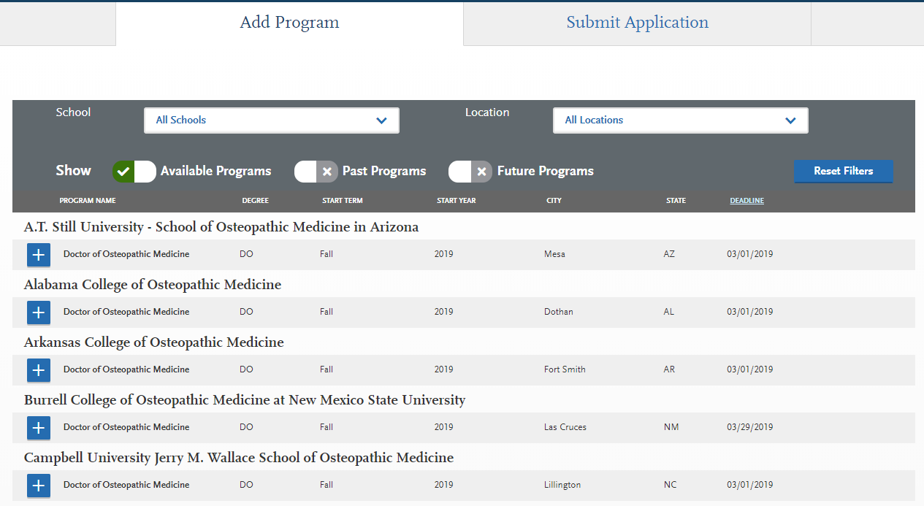
Section 4: Program Materials
Notes:
The Program Materials Section contains pages of college-specific information for each medical school in AACOMAS. This may include:
General Admission Criteria & Process
Prerequisites
Custom Questions
When students start their application, the first thing they will be asked to do is browse through AACOM’s directory of colleges and select programs of interest
Applicants can go back and select or deselect colleges at any time
Each college has a corresponding program page that lists their general admission requirements, prerequisites, and any program-specific questions they may require before applying
Applicants are encouraged to explore this directory and the Choose DO Explorer at ChooseDO.org before applying

Slide 22
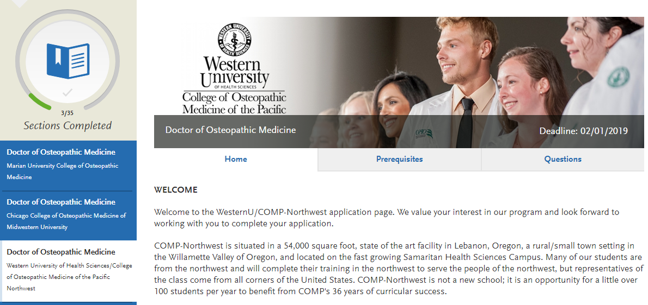
College Pages
Notes:
This is an example of one of the college pages. Encourage students to be sure to browse to each program’s page in the AACOMAS application that they’re interested in applying to in advance. These pages frequently list key program details, like:
Application deadlines
Links to the college website
Prerequisite information
Before submitting applicants will be asked to match the coursework they entered to a program’s prerequisite requirements
Program-specific questions
Questions range from simple yes/no questions to longer essay questions about an applicant’s interest in osteopathic medicine or the program. Applicant’s don’t want to be surprised that a program they’re interested in requires them to prepare an additional statement before they can submit. Applicants can click through each of these college pages at any time once they’ve expressed interest in applying.

Slide 23
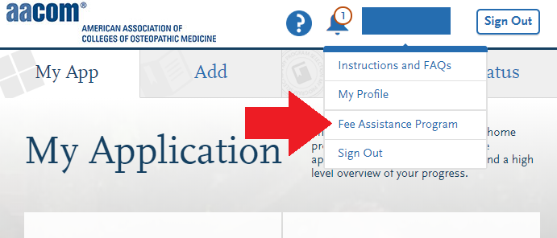
AACOMAS Fee Waivers
Fee waiver application is embedded in AACOMAS
Fee waivers cover the initial application fee to one COM for qualified applicants
See other requirements in the application
Waiver must be requested and approved before you submit your AACOMAS application
Once approved, you must submit your AACOMAS application within 14 days or the waiver will be forfeited
Colleges may waive their secondary application fees for students who receive an AACOMAS fee waiver
Notes:
Before students submit their application, they should check to see if they are eligible for an AACOMAS fee waiver. AACOMAS charges $198 for the first program applied to and $50 for each additional program. The fee waiver is worth $198 and covers the cost of the initial application.
Eligibility requirements are listed in AACOMAS instructions and are based on household income. To qualify, applicants must upload a scanned copy of the previous year’s Federal Income Tax Return (Form 1040 or Form 1040EZ).
Applicants can find the fee waiver form to apply in the drop-down at the top of their AACOMAS application. After they’ve determined that they are eligible for the program, students should submit their fee waiver form about two weeks prior to when they think they’ll be ready to submit their AACOMAS application.
When a decision is made on their fee waiver application, AACOMAS will notify applicants through their application, and will also send them an email. It is very important that students do not submit their application until they receive your fee waiver decision because the fee waiver is not retroactive.
If a student is awarded a fee waiver, they have 14 calendar days from the award date to submit their AACOMAS application. The fee waiver amount will automatically be applied to their account during the payment process. If a student applies to additional programs beyond the scope of their awarded fee waiver, they may be responsible for additional program fees.
In the prior cycle, AACOMAS granted waivers to all (100% of) eligible applicants.

Slide 24
Submitting & Monitoring Your Application
Application Statuses
In Progress
Received / Incomplete
Complete
Verified
Monitoring Your Materials
Notes:
Once a student has completed those four AACOMAS sections, they might be ready to submit.
Applications will be considered In Progress until they have submitted to at least one college.
Once a student hits submit and pays, their application will be considered Received and awaiting materials. Applicants can submit their application before their transcripts and evaluations are received by AACOMAS. AACOMAS will not review an application, however, until all transcripts and payments are received. Students can go back and submit to additional institutions at any time before their deadlines.
Once transcripts are received, an applicant’s application status changes to Complete and their application is placed in line to be verified by our AACOMAS Customer Service Team. Verification is the process used to ensure all coursework was entered correctly and consistently. Since credit values, grade values, and course subjects vary widely from school to school, programs need some type of standardization so they can accurately compare applicants. This standardization is achieved by using an applicant’s coursework to create a standard set of GPAs, ensuring each applicant is compared to other applicants fairly and equally. Verification typically takes less than a week, but peak processing times may extend this timeline.
Once complete, applicant’s will receive a notification that their application's status was changed to Verified.
Student’s can track the status of their application, official transcripts, and letters of recommendation submitted through AACOMAS on the Check Status tab inside their AACOMAS application.

Slide 25
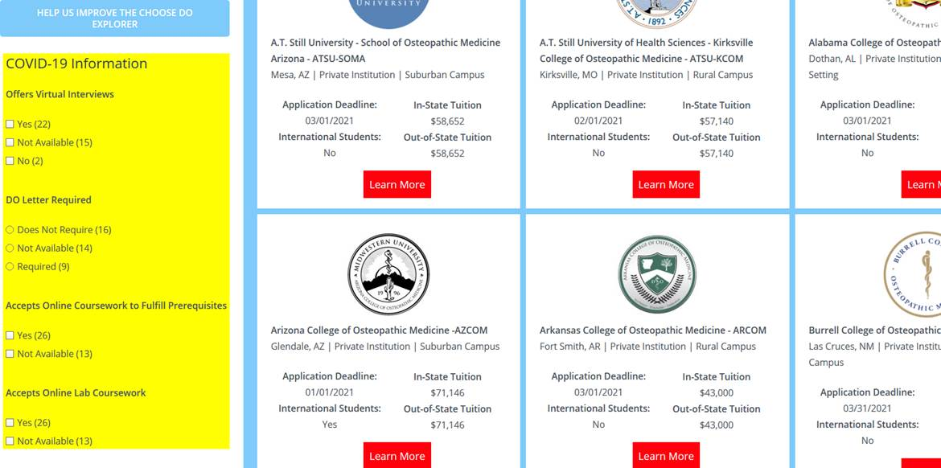
Notes:
In 2019, AACOM launched the Choose DO Explorer, our online search tool created for prospective students and health professions advisors.
The Explorer is intended to serve those who wish to join the growing community of osteopathic physicians by providing information on school locations, dual degree options, institutional campus setting, mean overall GPA and MCAT scores for enrolled students, and application deadlines.
Now, you will find specific COVID-19 filterable criteria in the explorer. You can see it highlighted on the screen in yellow here. Things such as whether institutions are offering virtual interviews, changes to letters of recommendation requirements, and more.

Slide 26
2020 Entering Class Profile
Mean MCAT Scores
Psychological, Social & Bio | 126.92
Bio & Biochemical | 126.29
Chemical & Physical | 125.89
Critical Analysis & Reasoning | 125.20
Total MCAT | 504.31
Mean GPA
Science | 3.45
Non-Science | 3.64
Overall | 3.54
Source: Applicant data from AACOMAS application
Notes:
We did want to share with you the 2020 Entering Class profile. This information compares to an average MCAT score for the 2019 entering class of 504.22, an average Science GPA in 2019 of 3.50, and an oaverage overall GPA in 2019 of 3.57. We often get asked for baseline acceptance and matriculation statistics but please know that there are many prospective student that get into our programs with lower scores, and there are some that reach these thresholds that do not get into our programs. Just as our medical students are taught to focus on treating the whole patient, the acceptance process is also holistic, and the numbers reflected here are averages.

Slide 27
Pulling Everything Together
Start filling out your AACOMAS Application
If eligible, apply for an AACOMAS fee waiver
Send to AACOMAS:
Official transcripts of ALL colleges attended from registrar
Official MCAT scores from AAMC
Submit your application and monitor your status
Ensure receipt of official transcripts and letters of recommendation
Ensure your application is complete and verified

Slide 28
Contacting AACOMAS Customer Service
For Applicants:
The Applicant Help Center is a fully-searchable resource that contains instructions for filling out each section of the application and sending in all required materials.
Contact AACOMAS Customer Service:
Open Monday-Friday, 9am-5pm ET
Phone: (617) 612-2889
Email: aacomasinfo@liaisoncas.com
Notes:
There are several resources to assist you in completing your application if you get stuck.
Our AACOMAS Customer Service team can be contacted Monday-Friday, between 9am-9pm ET.
We also have an online Applicant Help Center. This is a fully-searchable resource that contains instructions for filling out each section and sending in all required materials.

Slide 29
Thank You!
Notes:
We encourage you to explore our web site and learn more about osteopathic medicine and about our incredible students. We look forward to some of you joining their ranks., and I look forward to taking your questions.

