Slide 1
Pre-Orientation Transfer Workshop (Overview)
University of Florida College of Liberal Arts and Sciences

Slide 2
Essential Reminders
Create your Gatorlink username and password
Create your UFL.EDU e-mail account
Check your UFL.EDU e-mails REGULARLY
Request for all academic credentials to be sent to Office of Admissions
Official transcripts from all colleges attended
Test score reports (AP, IB, AICE, CLEP)
International Student Transfers
IELT/TOEFL score report
Read the Admissions Comments/Conditions on the Office of Admissions Letter

Slide 3
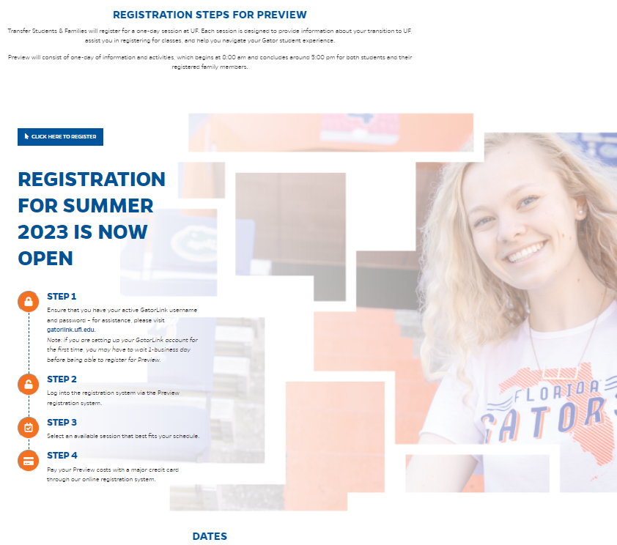
Pre-Orientation Checklist
Register for Transfer Orientation
https://welcome.ufl.edu/orientation/transfer/

Slide 4
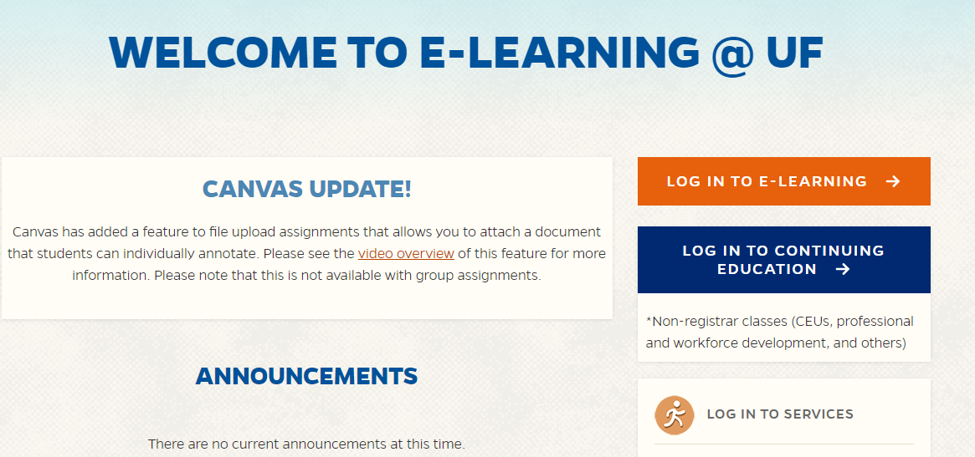
Pre-Orientation Checklist
Check for enrollment in Canvas CLAS Transfer Transition Course
https://elearning.ufl.edu/
Click on “Log-In to E-Learning”
Need UF Gatorlink Username and password (ufl.edu e-mail account)

Slide 5
Pre-Orientation Checklist
Created Gatorlink username and password?
Have a UFL.EDU e-mail account set up?
And still not enrolled in the CLAS Transfer Transition Course?
Send an e-mail to clastransferpreview@advising.ufl.edu from your UFL.EDU account
Subject line: Not enrolled in CLAS Transfer Canvas Course
Provide full name and UF ID #

Slide 6
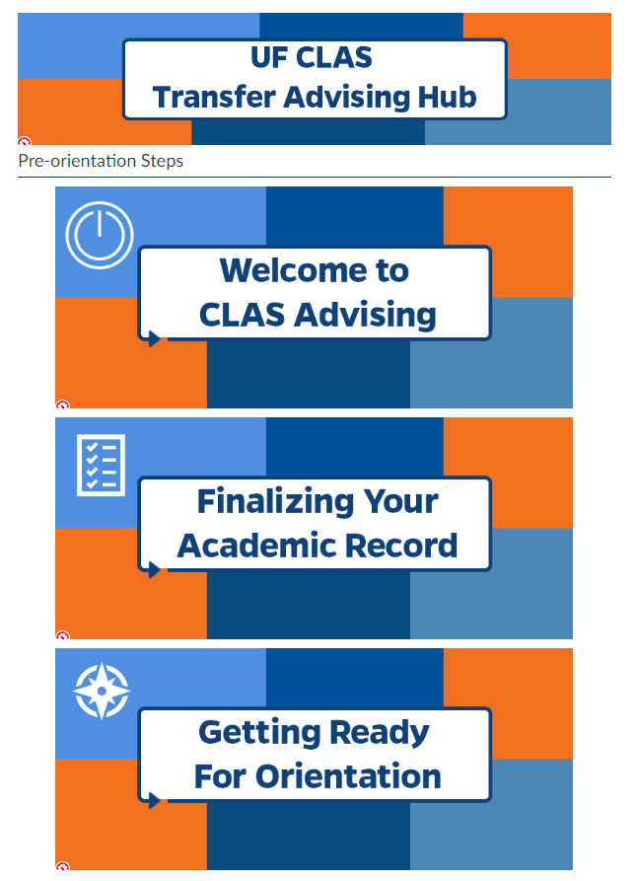
Pre-Orientation Checklist
Complete the Pre-Orientation Steps in the CLAS Transfer Transition Course
Welcome to CLAS Advising (Module 1)
Identify your department advisor
Finalizing Your Academic Record (Module 2)
Test Scores
Transcripts
Holds
Getting Ready for Orientation (Module 3)
Transfer Admissions Agreement Form
Transfer Prep Exercise
1
2
3

Slide 7
Check your UF Academic Record
ONE.UF.EDU
Platform for all your UF records
Transfer Credit Report
UF Transcript
Degree Audit
Schedule of Courses
Review Available Courses
“Register/View Schedule”
Registration System – register on Day of Preview

Slide 8
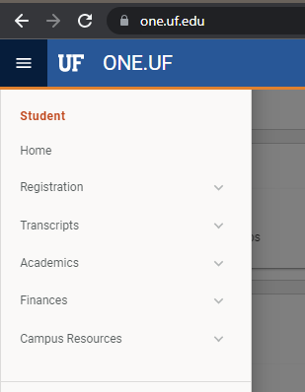
Transfer Credit Report (ONE.UF)
Click on the MENU
Click on Transcripts
You will see “Transfer Credit Report”. Make sure it is populated with your incoming credits.
Video on how to access your Transfer Credit Report is in the CLAS Transfer Transition Course.

Slide 9
UF Courses
State of Florida Course # System – uses Common Numbering across FL Public Colleges
Non-Florida or Private Florida or Non-Common Florida Course #
3 letter prefix (Department)
4 digit number (Specific Course)
Suffix
L = Lab
C = combination lecture/lab
Ex: BSC2005C
BSC (Biological Science)
2005 (Specific Course)
C (Combined Lecture/Lab)
BSC1005C = BSC2005C
Same course if Prefix is the same and last 3 digits of the number is the same.
Admissions assigns appropriate department
No course number equivalent
Unless it is in Transferology
Not always correct
4 digit number is usually
L000
U000
T000
XUF___
Courses will not count for requirements until they have been evaluated

Slide 10
Evaluating for Course Equivalency
Check Transferology (if listed here, it will post as a UF course)
https://www.transferology.com/school/ufl
If not in Transferology (for next steps after attending Transfer Preview)
Contact the Undergraduate Coordinator for the department from your UF e-mail account and provide the following:
Name
UF ID #
Listing of courses from the original school you want evaluated
Syllabi for all courses attached in word or PDF format (required)
Note: Courses are evaluated by the individual departments.

Slide 11
What Does Transfer Preview Day Look Like?
Check In & Continental Breakfast
Welcome
Student Engagement Activities
UF Resources
Lunch on your own
CLAS Presentation
Department Advising
Register on your own

Slide 12
What if I have advising questions after meeting my department advisor?
Transfer Preview Q & A
Offered in the same evening
Registration Questions
Post Transfer Preview Appointments
Schedule an appointment with an advisor for the next business day after orientation.
Seats in needed courses are held for new transfer students for each Transfer Preview session.
You DO NOT need to have your schedule completed on the day of Transfer Preview.

Slide 13
Questions?
Robert Kwong
clastransferpreview@advising.ufl.edu

