Slide 1
Pre-Orientation Workshop II
CLAS Transfer Transition Course OverView

Slide 2
Completing Pre-Orientation Exercises
UF E-Learning (https://elearning.ufl.edu/)
CLAS Transfer Transition Course
Pre-Orientation Steps
Welcome to CLAS Advising
Finalizing Your Academic Record
Getting Ready For Orientation

Slide 3
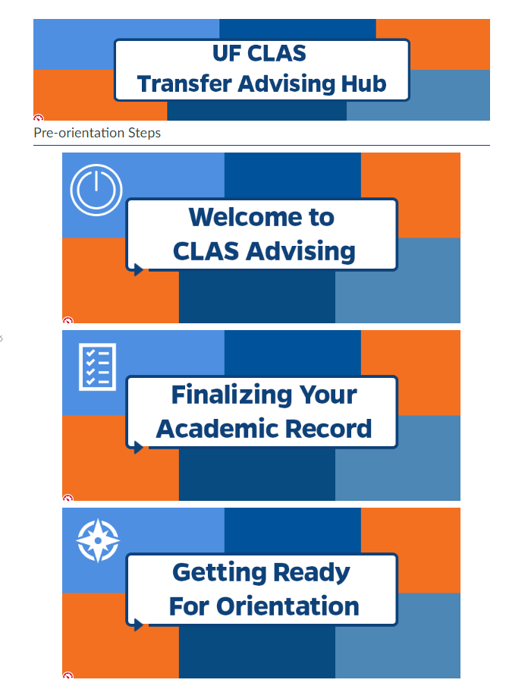

Slide 4
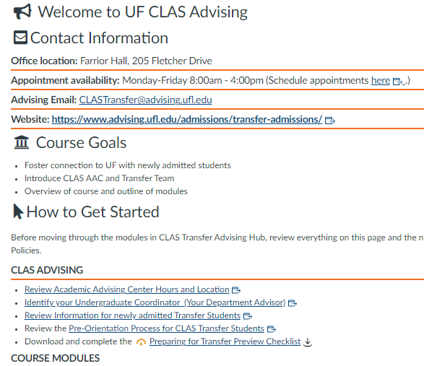
Welcome to CLAS Advising

Slide 5
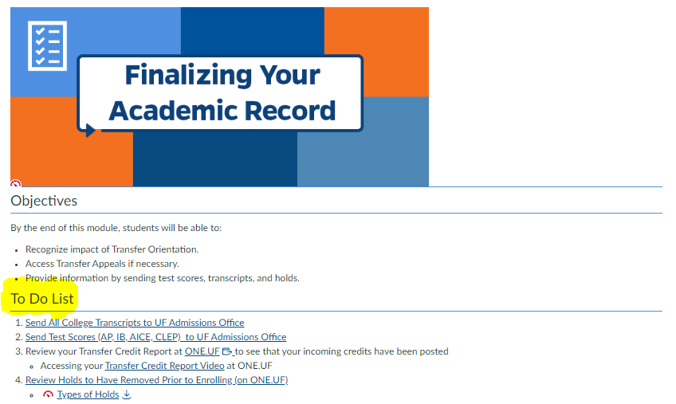
Finalizing Your Academic Record
Complete all the tasks!

Slide 6
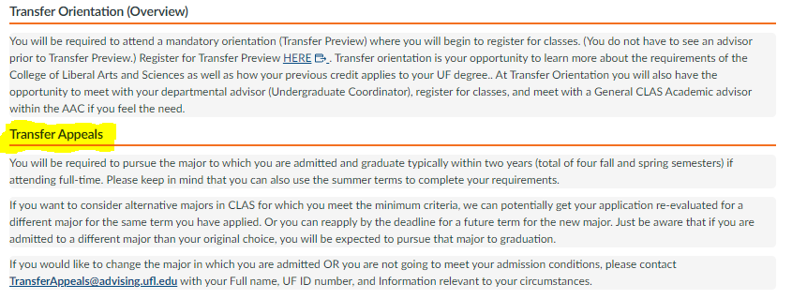
Please read this section! Important information about Transfer Preview and conditions of admissions!
Finalizing Your Academic Record (Bottom Page)

Slide 7
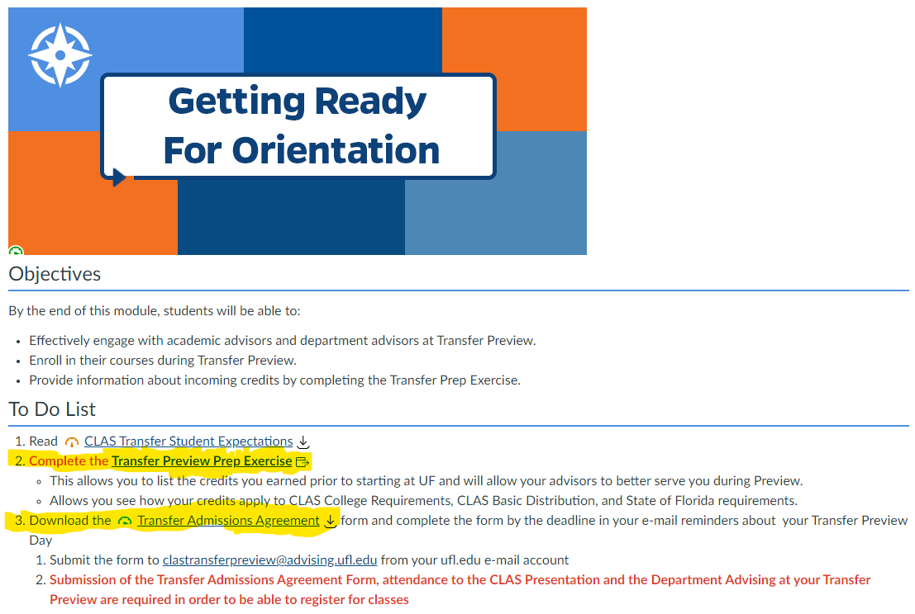
Getting
Ready for Orientation

Slide 8
Please read this section! Important information about Transfer Preview and conditions of admissions!
Getting
Ready for Orientation (Bottom Page)

Slide 9
Select one response

Slide 10
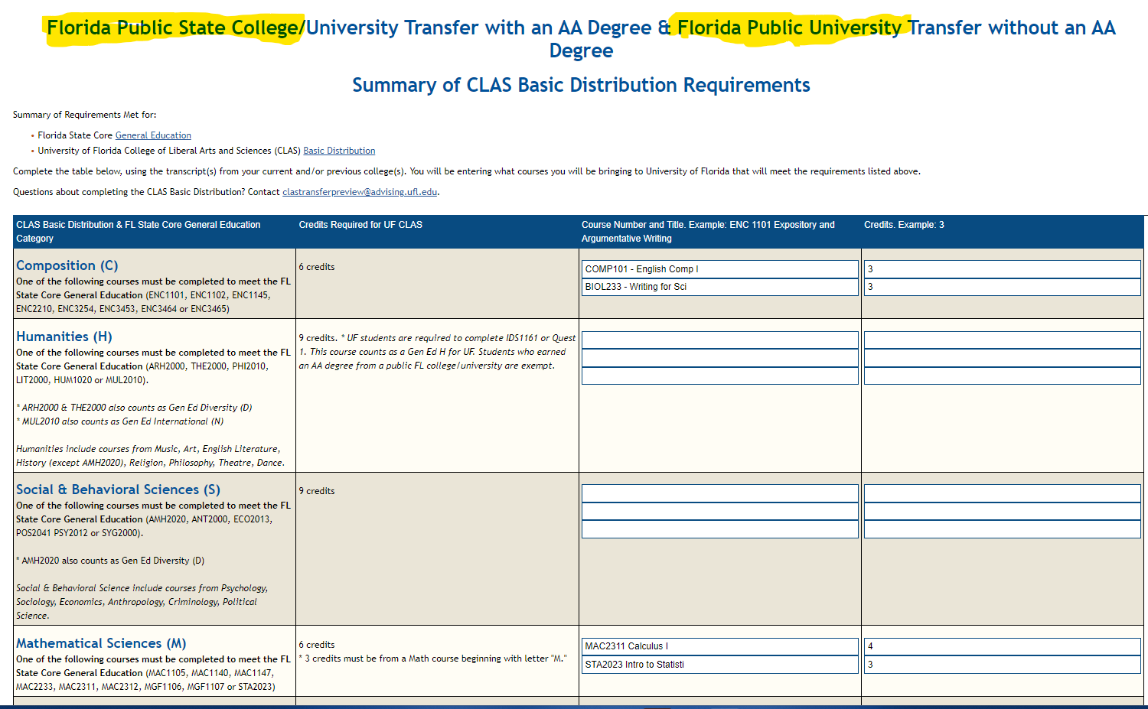

Slide 11
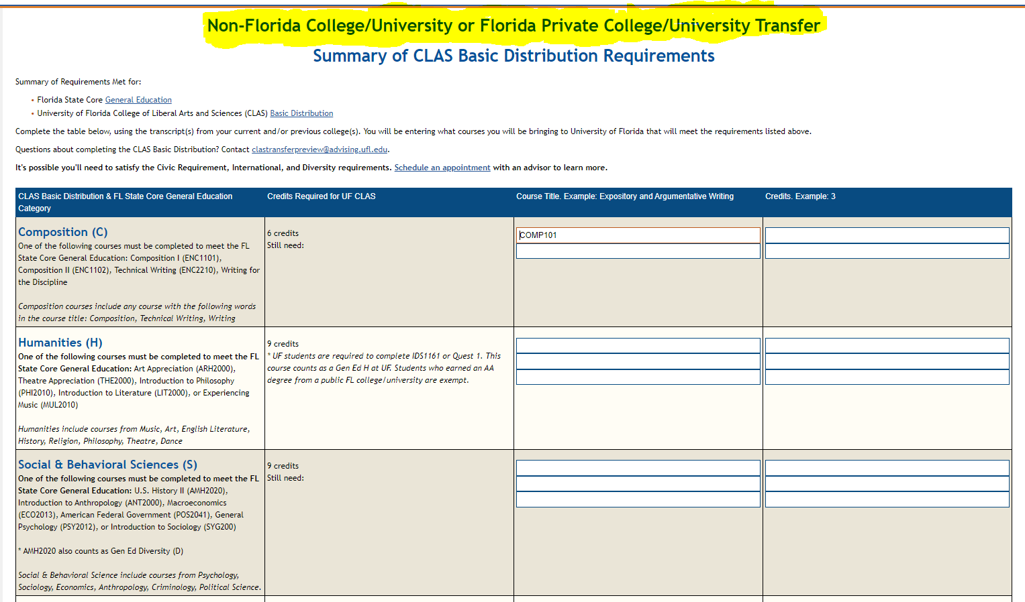

Slide 12
College Requirements

Slide 13
College Requirements

Slide 14
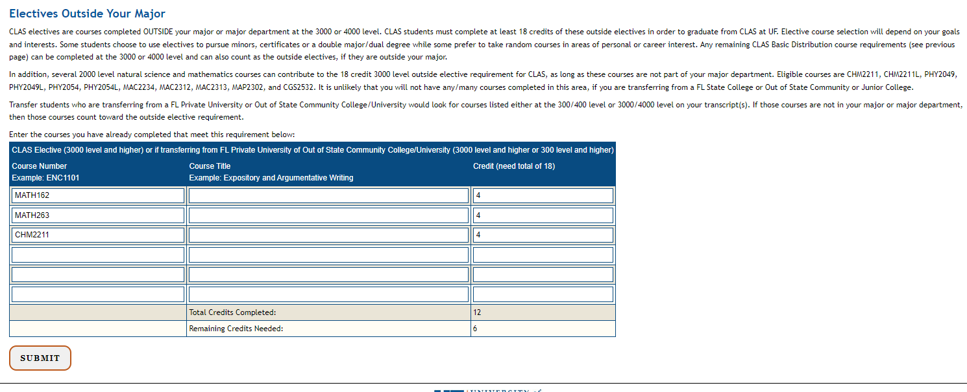
College Requirements
Enter any courses, if there are any.

Slide 15
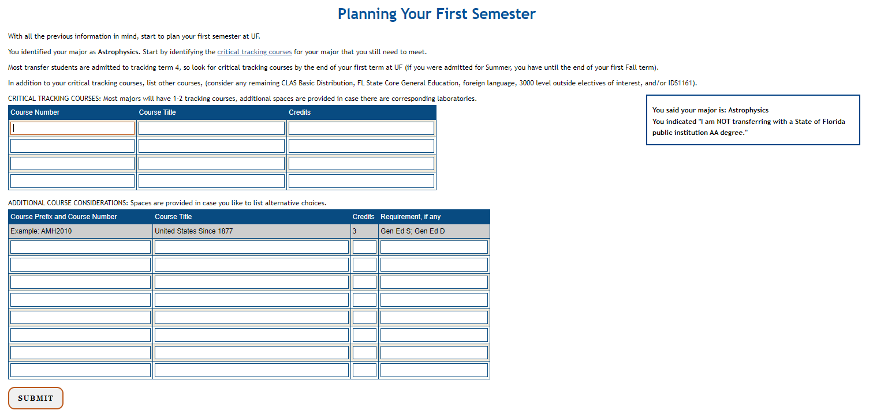

Slide 16
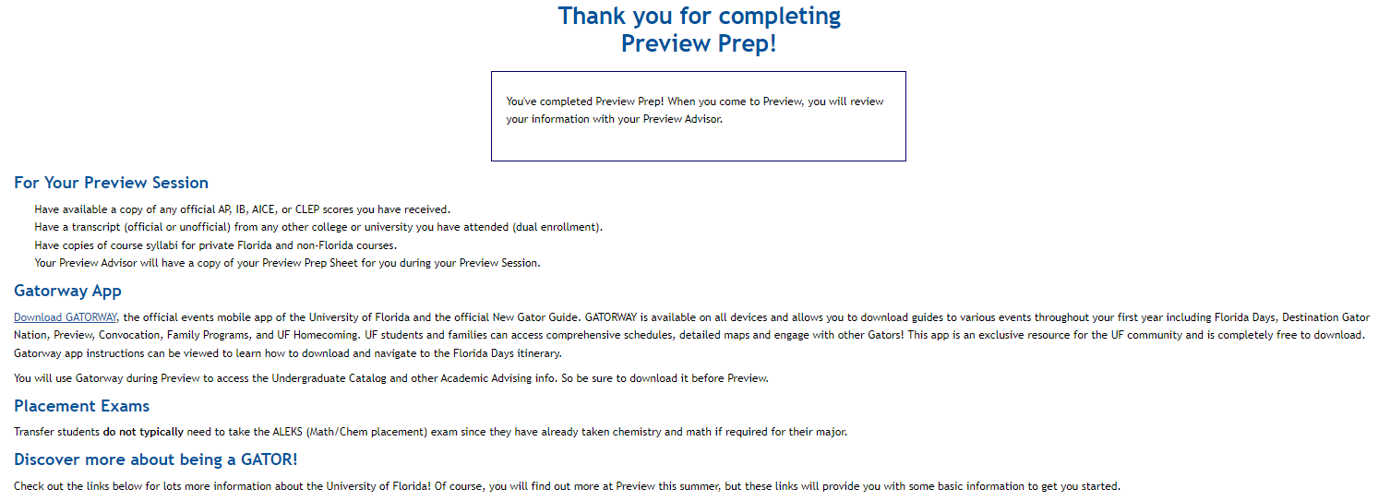

Slide 17
Email Confirmation Transfer Prep Completion
You will be sent an e-mail confirmation upon completion of Transfer Prep.
A link to your completed Transfer Prep is in the e-mail.
This Transfer Prep Summary can be used to determine what CLAS requirements remain.
CLAS Basic Distribution
Outside electives
CLAS Foreign Language
Useful tool for you to predict courses to register and for your CLAS advisors.
Can be used to help you avoid registering for courses that meet requirements that you may have already completed.

Slide 18
Short Demo of Transfer PRep

Slide 19
Not enrolled in CLAS Transfer Transition Course?
Created the following?
Gator link User Name
Gator Link Password
UFL.EDU email
Send an e-mail to clastransferpreview@advising.ufl.edu from ufl.edu e-mail
Subject line = Not Enrolled in CLAS Transfer Transition Course
Provide Full Name, UF ID #, major

Slide 20
Quick Reminders!
Use your UFL.EDU e-mail account for all communication
Register for Transfer Preview
Request to have all academic credential submitted prior to your first term at UF
Complete all the modules in Pre-Orientation Steps least 1 week prior to your Transfer Preview Day

Slide 21
Questions?
Email: clastransferpreview@advising.ufl.edu from your UFL.EDU email account.

